Slide 1
Search for the safest neighborhoods in Vancouver leveraging foursquare API
By MRIGANK KUMAR

Slide 2
OBJECTIVE
Vancouver is a multicultural city, people from around the world immigrate here to look for better opportunities, therefore search for the safest and best of neighborhood has to offer can be quite challenging.
Objective of this project is to narrow the list to few neighborhoods in which a person can find home based on their personal choices on what the locality has to offer.
The targeted audience for this project is mostly people who is from outside the country and students who has very little or no knowledge of the city and its neighborhoods.

Slide 3
data
First the data regarding the crime statistics of the city of Vancouver was used from the dataset available on kaggle.com, which was further used to visualize the neighborhoods based on their crime rate and severity.
After performing the above analysis foursquare API was used to get detailed venues of the neighborhood offerings with their location coordinates.

Slide 4
Project approach
Get the list of safest neighborhoods of the city of Vancouver by analyzing the crime stat dataset from kaggle.com
After getting the list of the desired neighborhoods sticking to those neighborhoods and further explore them leveraging foursquare API.
Then running k-means algorithm and then clustering the different neighborhoods based on their similarity index and dissimilarity index.
And then finally selecting the neighborhood based ones personal choice of top venues the neighborhood has to offer.

Slide 5
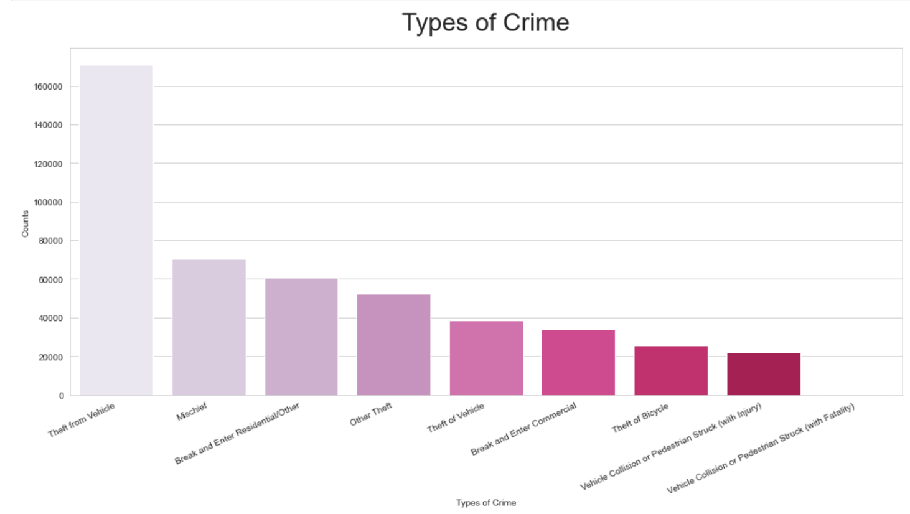
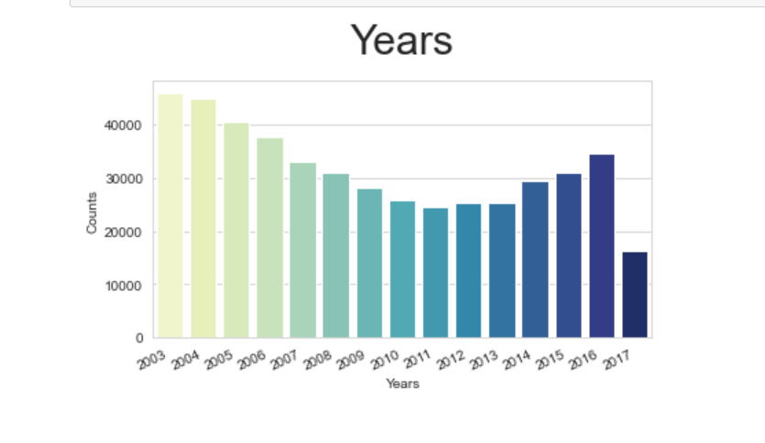
Visualization of crimes in the city based on year and type

Slide 6
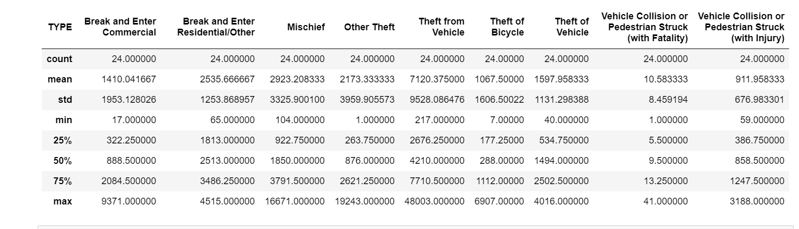
Exploratory data analysis of crime and their severity

Slide 7
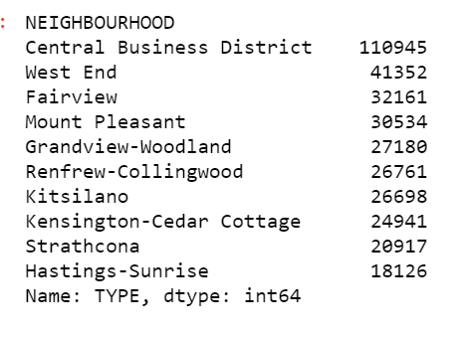
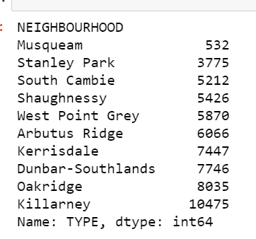
City names based on the number of crime committed

Slide 8
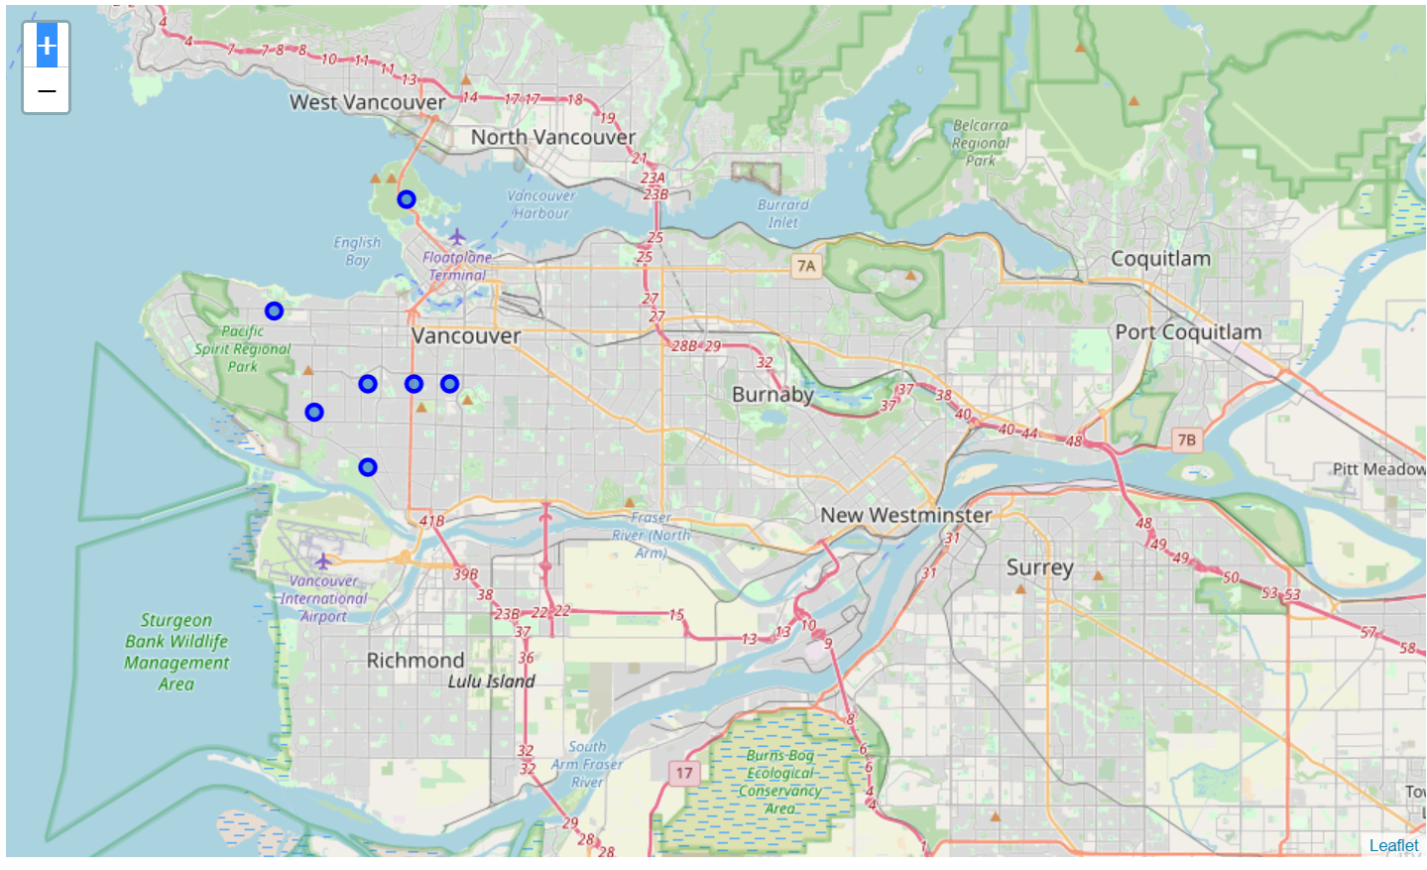
Staying clear of neighborhoods with high crime rate and focusing on neighborhoods with low crime rate

Slide 9
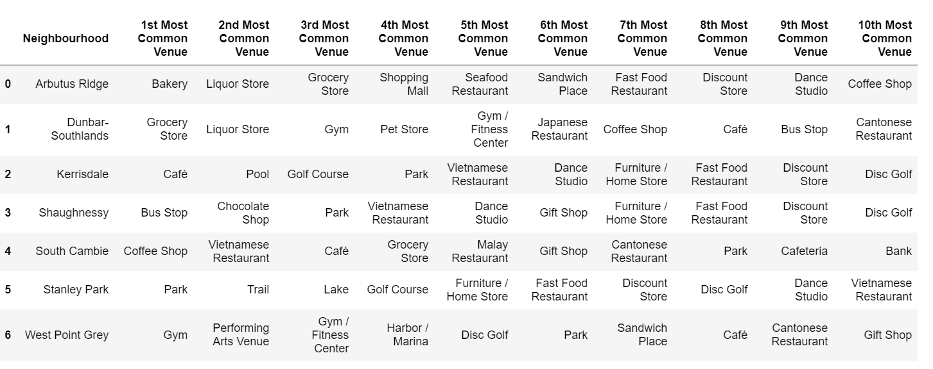
Exploring the neighborhoods based on top venues within 500M

Slide 10
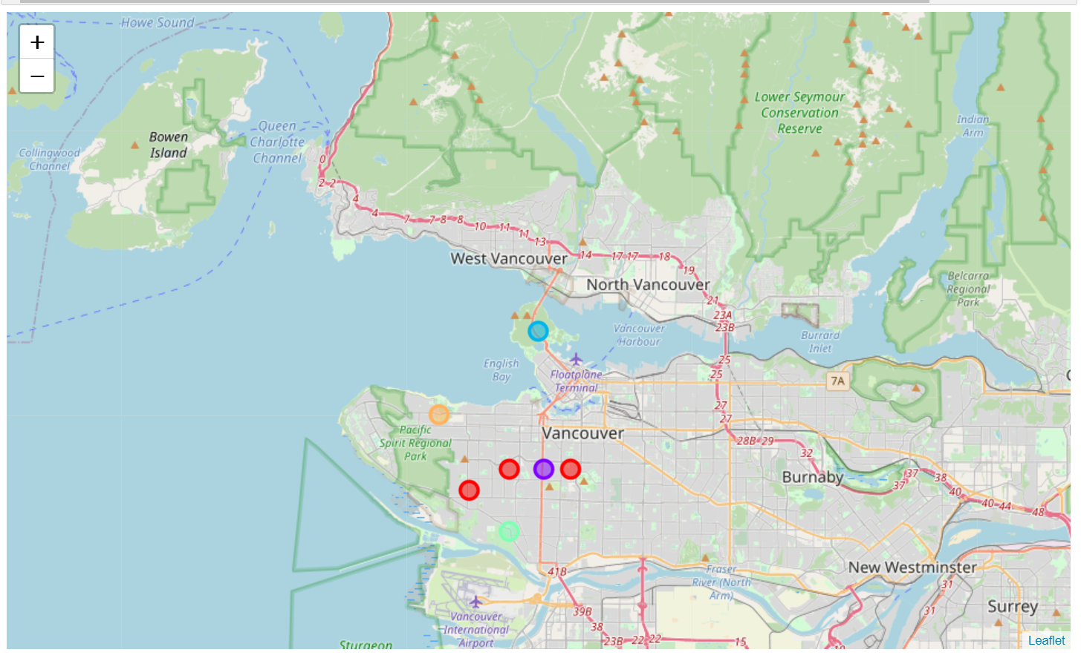
Results of k-means clustering
The neighborhoods are divided into 4 clusters of different color blue, yellow, red, purple based on their similarity measure. A person can select a neighborhood based on his personal choice to move in.
The above is result of k-means unsupervised ML algorithm deployed on the dataset.
Red is south cambie, arbutus ridge and dunbarsouthlands.
Purple is Shaughnessy.
Yellow is west point grey.
Blue is Stanley park.

Slide 11
Future steps
After exploring the neighborhoods future steps exploring the neighborhoods based on housing prices using more data employing web scrapping.
The project includes only limited number of venues further exploration can be done to get more holistic view of all the neighborhoods of the city.
Future steps can also include exploration based on preferred availability of jobs, based on that what neighborhood will be safe and offers ease of commute to workplace.

Slide 12
THANK YOU!

